Slide 1
FBO/BAO Partnership Retreat The Path Forward
December 6, 2017

Slide 2
Welcome
FBO & BAO Partnership n. A collaborative working relationship of FBO staff & BAO members to achieve a common goal(s) and objective(s)
Proposed FBO & BAO Partnership Goal
Develop & strengthen the FBO & BAO partnership to improve operational efficiency and effectiveness and achieve excellence in business processes across the University.

Slide 3
Objectives for Today
Share the FBO Strategic Priorities and the divisional goal setting process
Review the proposed FBO/BAO partnership goal and objectives
Confirm 2016 SWOT data associated with each proposed objective; identify approach to address
Outline a path to move forward on goals and objectives

Slide 4
Agenda
Morning
Program kick-off
FBO Strategic Priorities and FBO/BAO Partnership
Partnership Benefits and Concerns
Using the Partnership to address SWOT Weaknesses

Slide 5
Agenda
Afternoon
Recommending Approaches to Address Issues
Outline a Path to Move Forward
Identifying Areas of Interest
Wrap-up/Close

Slide 6
Brief Introductions
Name
Role / SCD
Years in role
Notes:
Jon

Slide 7
Proposed Session Guidelines
Be Present
Contribute your ideas
Respect for ideas of others
Listen to understand
Step Up / Step Back

Slide 8
FBO Strategic Priorities 2018-2021

Slide 9
2018-2021 FBO Strategic Priorities and Goals
WSU Focus Area/Goal | Proposed FBO Strategic Priority | Proposed FBO Division Goals
Financial Sustainability & Operational Excellence | Ensure WSU financial health and vitality | New tuition model & structure New budget model Improved & effective financial controls Address SOM/UPG financial issues Enterprise risk management Identify, applaud, & implement financial & budgetary best practices within SCDs Increase return on cash & grow endowment
All 7 Strategic Focus Areas | Be a “Best Place” to Work | h. Foster an inclusive and engaging environment to retain valued staff & support WSU as an employer of choice i. Develop a total rewards philosophy to enable WSU to attract, retain, and develop the top talent j. Innovate in labor management practices to be a model for strength in partnerships k. Become a talent management leader
All 7 Strategic Focus Areas | Align WSU physical space with 2028 Campus needs and ensure it delights all who visit/study/work here | l. Develop 10-year Facilities Master Plan m. Integrate facility & space management with new budget model n. Develop 10-year capital financing plan o. Implement “Facilities Forward”
Financial Sustainability & Operational Excellence | Create a culture of service through continuous improvement and collaboration | p. Improve internal & external customer service (e.g. Banner 9) q. Develop & implement a continuous improvement framework r. Improve Client Services by streamlining processes and providing easily accessible data & analytics s. Leverage partnerships to advance University-wide goals & positively impact the local community

Slide 10
Table Activity
Review the FBO Strategic Priorities and Division Goals on the chart at your table
Identify all Division Goals where you see an opportunity for FBO and BAO collaboration to achieve the divisional goal
Place a dot by those goals
Select a table group member to share your chart results with the larger group

Slide 11
FBO & BAO Partnership Goal & Objectives

Slide 12
FBO & BAO Partnership
Proposed Goal:
Develop and strengthen the FBO & BAO partnership to improve operational efficiency and effectiveness and achieve excellence in business processes across the University.
1. Collaboration & Communication:
a. Increase collaboration and enhance two-way communication between all FBO units and BAOs to improve understanding and appreciation from each perspective and work together toward common goals.
b. Identify and incorporate school, college and division (S/C/D) business unit needs and input throughout new system implementation projects, the operational policy review and revision process and decision making processes that define and impact the day to day business practices within S/C/D units.
2. Policy & Procedural Development, Application & Compliance
a. Collaboratively improve standardized procedures and consistency of policy application and compliance through communication, documentation and training:
i. Triage and Review of Process Breakdowns: Identify, prioritize and review process breakdowns which are impacting operational efficiency and effectiveness. Assemble a group of impacted stakeholders and perform a quick business process review to identify the problem, brainstorm both short-term and long-term process revisions or corrections, implement the short-term fixes and revisit the implementation to assess the success.
ii. Internal control: University wide, develop and sustain an effective environment of internal control over accounting and financial reporting to reduce the risk of errors or misstatements in financial and budgetary data, protect University assets and improve policy application and compliance.
iii. Daily operations: Develop and implement standardized, relevant, best practice policy and procedural communications, documentation and training.
iv. Financial reporting: Develop monthly, quarterly and annual standardized financial and budgetary reporting practices in conjunction with Banner 9 and New Budget Model report development; develop and implement related policy, procedure and training.
v. Financial sub certification: Identify established financial sub-certification policies and procedures in higher education and evaluate best practices, develop and implement related policy, procedure and training.
3. Development of Business Professionals
a. Collaboratively develop and deliver BAO and staff functional training (informed by policy and procedural development, application and compliance work above) to enhance consistency in practice and standardization of work products.
b. Provide BAO leadership opportunities to develop and retain strong business professionals across the University.
Proposed Objectives:

Slide 13
Table Activity
Refer to your notes from the Pre-retreat preparation
Share your potential partnership benefits with table members – reach consensus on what your table group views as the most important 3-5 benefits of the partnership and its proposed goal/objectives
Follow same process with concerns – reach consensus on 3-5 key concerns about the proposed partnership goal/objectives
Prepare to share your table’s conclusions in a group discussion

Slide 14
Addressing SWOT Weaknesses with the FBO/BAO Partnership

Slide 15
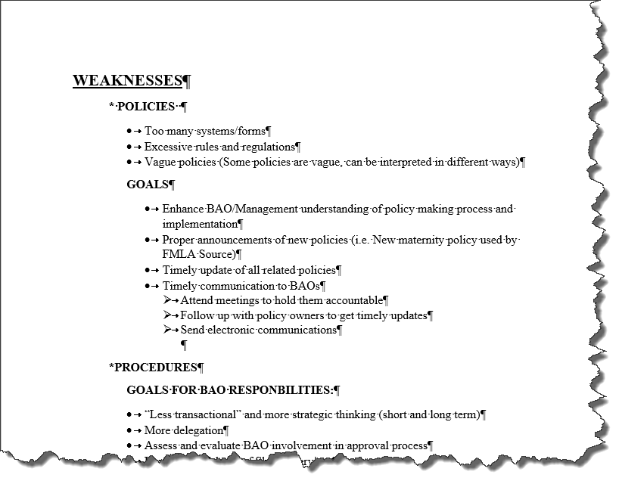

Slide 16
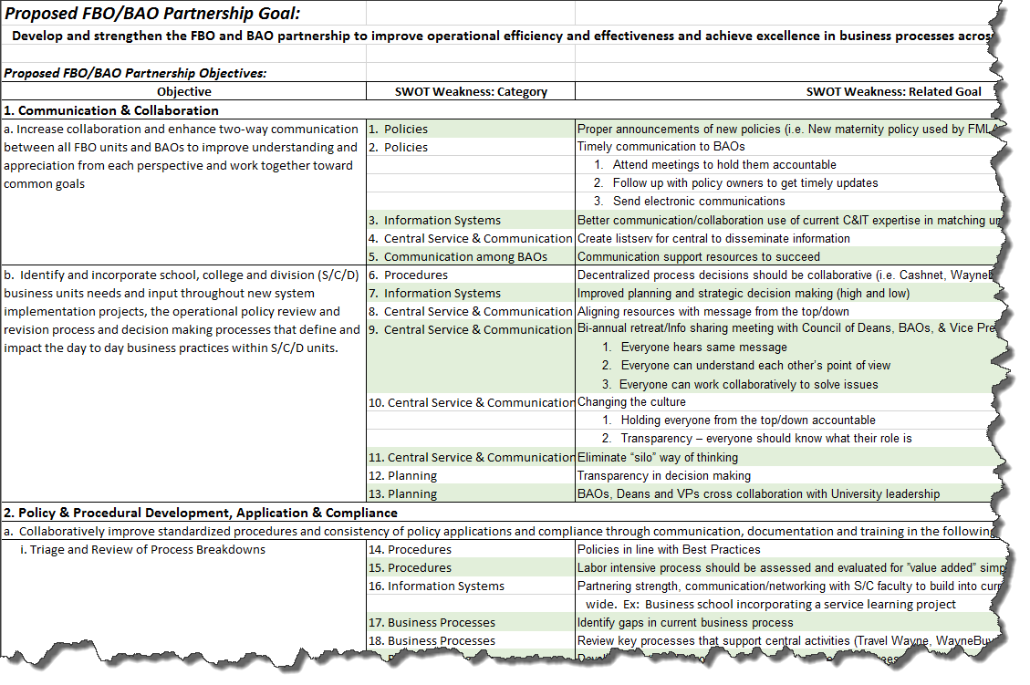

Slide 17
Table Activity
Part 1
Review your assigned 2016 SWOT items:
Decide if each item (SWOT goal and related weakness category) is still a relevant item that should be addressed through future efforts.
If not, cross out the item on your handout

Slide 18
Table Activity (cont’d.)
Part 2
Meet with your designated “partner table.”
Review your responses with the other table for each assigned item
Reach consensus about whether each SWOT item is still relevant.
Be prepared to explain any items where you believe an update/change is warranted

Slide 19
Approaches to Address SWOT Items

Slide 20
How do we tackle these issues?
Different approaches based on nature of issue
FBO-led University initiatives with BAO involvement (e.g., Banner 9 project)
FBO and BAO collaborative improvement activities or initiatives
FBO-owned improvement activities or initiatives
BAO-owned improvement activities or initiatives

Slide 21
Table Activity
Part 1
For each of your table’s assigned items:
Discuss what you believe would be the most effective approach for addressing that issue
Record the code (1-4) for that approach in the column labeled “Approach to Action”

Slide 22
Table Activity (cont’d.)
Part 2
Meet with your designated “partner table.”
Review your recommended approach for assigned items with the other table to reach consensus on an approach
Record your consensus recommended approach for each item on the new form provided for your discussion
Forms will be collected at the end of the activity

Slide 23
A Path to Move Forward:
Using the BAO Meeting
in a New Way

Slide 24
An Opportunity for Change
Reasons for change?
Create an opportunity to engage the membership in thoughtful, focused, continuous quality improvement activities to address SWOT weaknesses and related goals within the framework of the FBO/BAO Partnership
Provide time for impactful collaboration between BAO membership & central staff
Let’s try something new without creating a new meeting

Slide 25
New Format & Focus Overview
Five Meetings Focused on Continuous Quality Improvement:
Identifying solutions for process challenges
Best practice implementation opportunities
Training development needs
Remaining Seven Meetings Focused on Information Sharing:
Tracking and reporting on focused topic progress
Project updates from member participants i.e., RCM, Banner 9, Deep Dive
Scheduled presentations i.e., current agenda items

Slide 26
2018 Meeting Overview
January (transition)
March
May
July
September
Continuous Quality Improvement Focus
Collaborative Working Meeting Format
February
April
June
August
Oct, Nov, Dec (year-end)
Information Sharing Focus
Attendees: Both BAOs and FBO Leaders and related staff
2 hour duration
Current 1.5 hour duration
Presentation Meeting Format
Attendees: Primarily BAOs and Presenters

Slide 27
Collaborative Working Meeting Format
Extend to 2hr meeting, 1:30 – 3:30pm
Round tables with six-eight people
Attendees to include BAO membership and central staff best able to impact and implement change for the meeting’s topic
One process improvement, best practice implementation or training development topic per meeting

Slide 28
Presentation Meeting Format
Existing 1.5hr meeting, 1:30 – 3:00pm
Conference seating or group’s preference
Attendees to include BAO membership and presenters
Standing Agenda Items:
Continuous Improvement topic updates
University project participant updates
Additional Agenda Items:
Presentations on relevant topics impacting business affairs operations
When possible general presentations would be moved to the Administration Conference Agenda

Slide 29
Moving Forward
Use the output from this retreat to identify topics for the collaborative working meetings throughout 2018 (January 2018 meeting)
Coordinate FBO lead/staff attendance to reflect topics chosen for 2018
Review and evaluate this approach in October 2018 for continuance in 2019; make adjustments

Slide 30
Feedback and Discussion

Slide 31
Wrapping Up
Notes:
Jon

Slide 32
FBO & BAO Partnership
Proposed Goal:
Develop and strengthen the FBO & BAO partnership to improve operational efficiency and effectiveness and achieve excellence in business processes across the University.
1. Collaboration & Communication:
a. Increase collaboration and enhance two-way communication between all FBO units and BAOs to improve understanding and appreciation from each perspective and work together toward common goals.
b. Identify and incorporate school, college and division (S/C/D) business unit needs and input throughout new system implementation projects, the operational policy review and revision process and decision making processes that define and impact the day to day business practices within S/C/D units.
2. Policy & Procedural Development, Application & Compliance
a. Collaboratively improve standardized procedures and consistency of policy application and compliance through communication, documentation and training:
i. Triage and Review of Process Breakdowns: Identify, prioritize and review process breakdowns which are impacting operational efficiency and effectiveness. Assemble a group of impacted stakeholders and perform a quick business process review to identify the problem, brainstorm both short-term and long-term process revisions or corrections, implement the short-term fixes and revisit the implementation to assess the success.
ii. Internal control: University wide, develop and sustain an effective environment of internal control over accounting and financial reporting to reduce the risk of errors or misstatements in financial and budgetary data, protect University assets and improve policy application and compliance.
iii. Daily operations: Develop and implement standardized, relevant, best practice policy and procedural communications, documentation and training.
iv. Financial reporting: Develop monthly, quarterly and annual standardized financial and budgetary reporting practices in conjunction with Banner 9 and New Budget Model report development; develop and implement related policy, procedure and training.
v. Financial sub certification: Identify established financial sub-certification policies and procedures in higher education and evaluate best practices, develop and implement related policy, procedure and training.
3. Development of Business Professionals
a. Collaboratively develop and deliver BAO and staff functional training (informed by policy and procedural development, application and compliance work above) to enhance consistency in practice and standardization of work products.
b. Provide BAO leadership opportunities to develop and retain strong business professionals across the University.
Proposed Objectives:

Slide 33
FBO & BAO Partnership Retreat Area of Interest
Name: _________________________
Below, please circle the partnership objective(s) in which you may have interest in planning, committee or work group activities:
Collaboration & Communication
Efforts to increase & enhance two-way communication
Participation in a University level project or committee
Policy & Procedural Development, Application & Compliance
Triage and Review of Process Breakdowns
Internal Control
Daily Operations – Standardized relevant, best practice policy and procedural communications, documentation and training
Financial Reporting
Financial Sub Certification
Development of Business Professionals
Development/delivery of training materials
Participate in leadership opportunities

Slide 34
Thank You!

